Slide 1
MyBlueprint
2025-2026 Course Selection
LOYOLA C.S.S. EDITION

Slide 2
IMPORTANT DATES
MyBlueprint Opens: | MyBlueprint Closes:
Monday, January 6th, 2025 | Monday, February 3rd, 2025

Slide 3



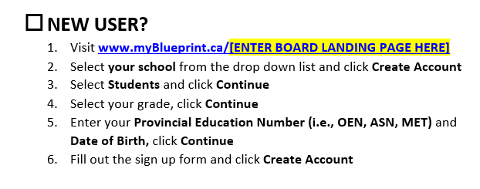
MyBlueprint: Log On
Activation Key: loyolacss

Slide 4
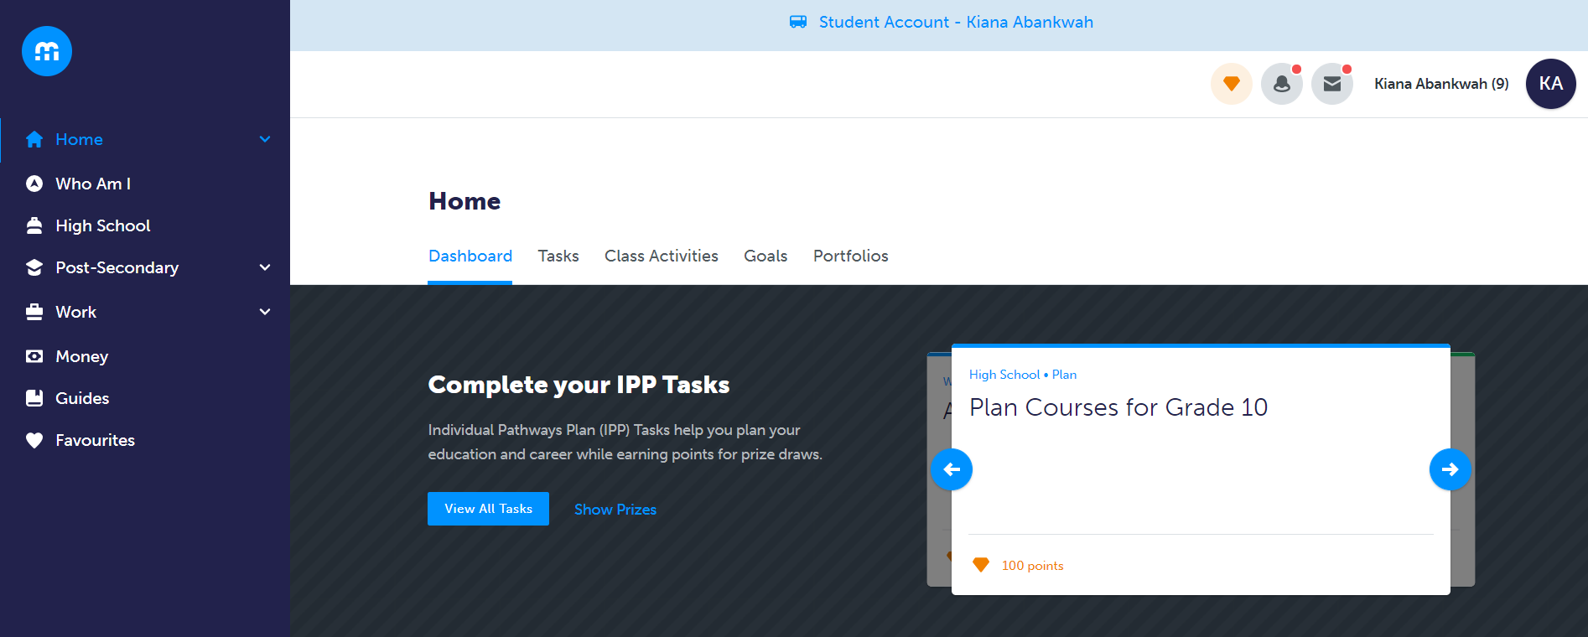
MyBlueprint Student Dashboard

Slide 5
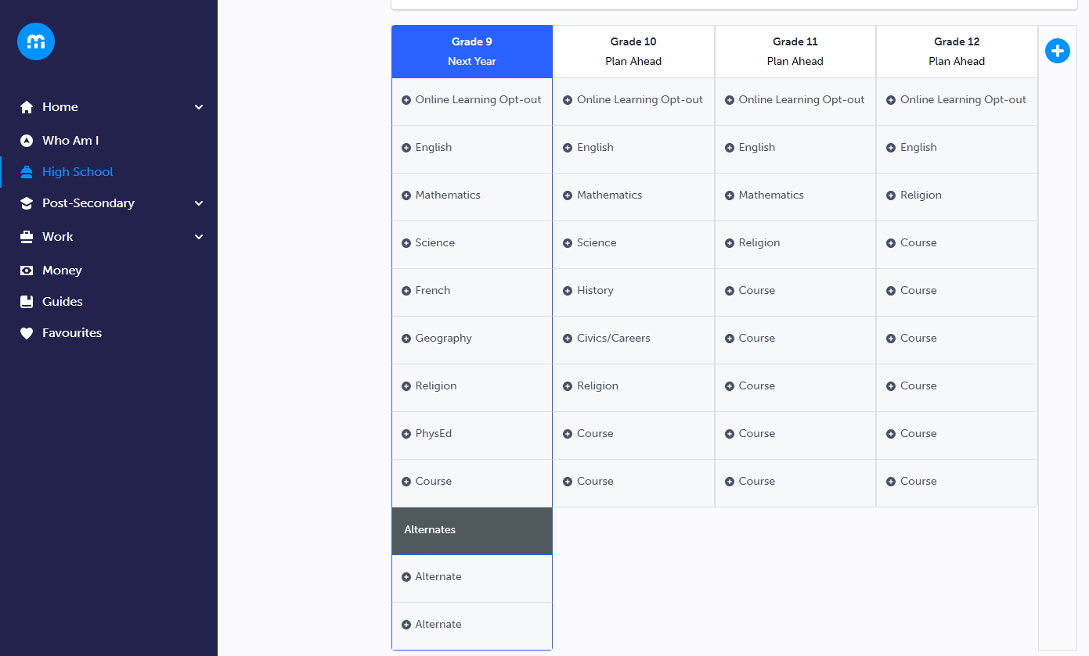
Step #1: Begin Course Selection

Slide 6
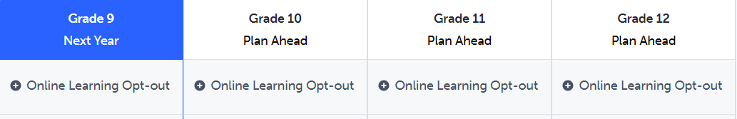
Opt-Out Option
“Beginning with students who entered Grade 9 in the 2020-21 school year, all students must earn at least two online learning credits as part of the requirements for an Ontario Secondary School Diploma (OSSD), unless they have opted out or been exempted”.-Ministry of Education
If you choose to Opt-Out of Online Learning, you can select the OPTOUT code. The Online Learning Opt-out box will be the first slot in your High School Plan (see example below).
If you don’t want to opt out, do not click on the online learning opt-out and proceed with your course selection.

Slide 7
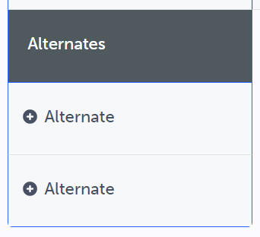
2 Alternate
Courses Required!

Slide 8
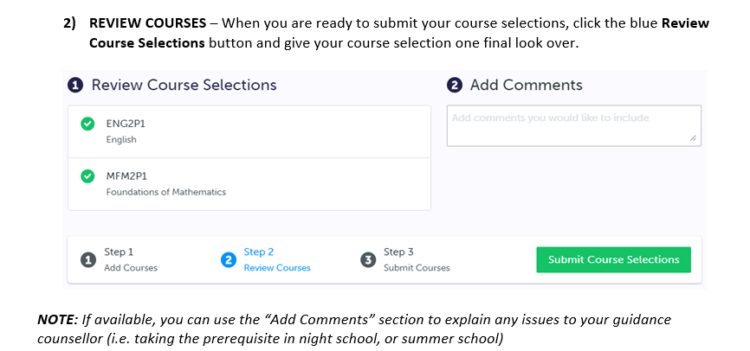
Step #2: Review Courses
Notes:
Check to be sure you have selected the correct pathway level ( ie academic, applied…)

Slide 9
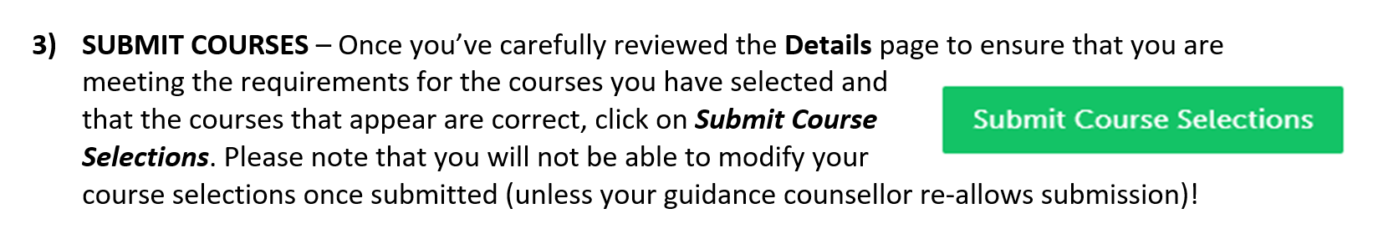
Step #3: Submit Courses

Slide 10
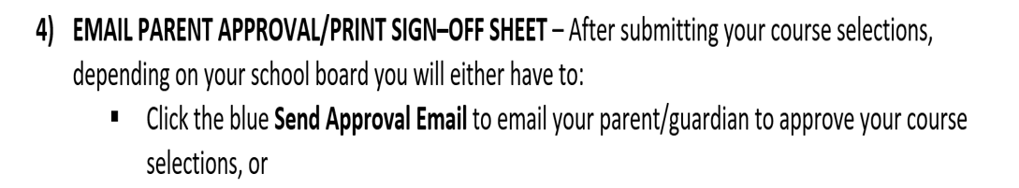
Step #4: Parent/Guardian Approval Email
*Print the signed form and bring it to your Guidance Counsellor

Slide 11
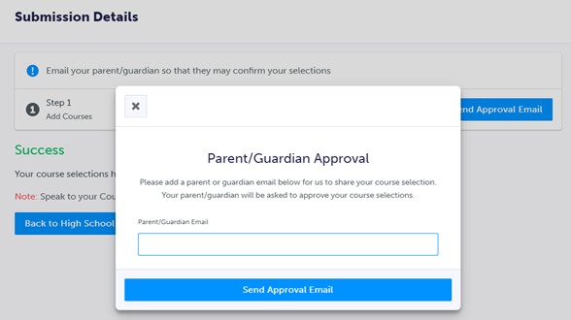
Parent/Guardian Approval Message

Slide 12
Re-Allow Submission
Need to make a change AFTER submission?
You must make an appointment with your Guidance Counsellor if you submitted your course selection, but need to make a change. Your Guidance Counsellor will “Re-Allow Submission” in order for you to make changes.

Slide 13
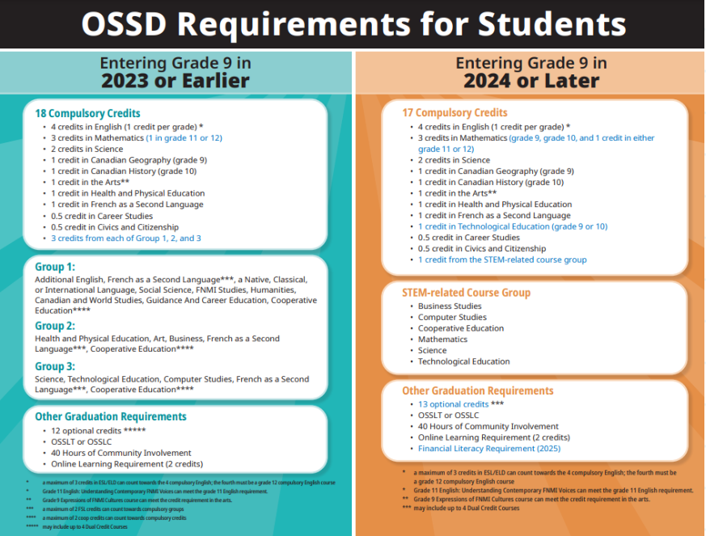

Slide 14

Courses at Loyola for 2025-2026
GRADE 10 COURSES:
ASM2O1-Grade 10 Media Arts
TGJ2O1-Grade 10 Communications Technology
GRADE 11 COURSES:
ASM3M1-Grade 11 Media Arts
ENG3UD-Grade 11 Black Voices in Literature
NBE3U1 or NBE3C1-Grade 11 (English)Understanding Contemporary First Nations, Métis and Inuit Voices
TGG3M1-Grade 11 Communications Technology: Print and Graphic Design
GRADE 12 COURSES:
SCH4C1-Grade 12 College Chemistry
*Please Note: Courses are tentative based on student enrollment. Detailed course descriptions are available on MyBlueprint.

Slide 15
CURRENT GRADE 9 STUDENTS: GRADE 10 OPTIONS
English Program | French Immersion Program | Extended French Program
English Religion Math Science History Civics and Careers (CIVCAR) 2 Electives | French (FIF2D1) English Religion (HRE2OM) Math Science History (CHC2DM) Civics and Careers (CIVCAM) 1 Elective | French (FEF2D1) English Religion Math Science History (CHC2DF) Civics and Careers 1 Elective
•Must select 8 courses
•Must select Art credit if not obtained in Gr. 9
•Must select Technological credit if not obtained in Gr. 9
•PPL2OM (males) or PAI2OF (females) if students are missing Physical Education credit
•Complete Community Service Hours
Notes:
For students who are currently in grade 9, you will be selecting your grade 10 courses. Please keep in mind if you did not have Visual Arts, Drama, Guitar or Music in your grade 9 year you must choose a course that falls under the Arts category for your grade 10 year.
For students who are currently in Cohort C and for that reason have not been able to take a Phys. Ed courses. You will be able to select PPL2OM for the boys and PAI2OF for the girls,
If you are a French Immersion or French Extended student, please take care to properly select the courses you must take in French in order to meet your hours or instruction requirements for that specific certificate. We are excited to offer to all grade 10 French students: Art Dramatique (Drama). If you are planning to take your History or Civics in summer school in order to still make room for an additional elective, please do not select it in myBlueprint. In the notes section let us know that you have purposely not selected the course because you are intending to take it in summer school.

Slide 16
CURRENT GRADE 10 STUDENTS: GRADE 11 OPTIONS
English Program | French Immersion Program | Extended French Program
English Religion Math 5 Electives | French (FIF3U1) Religion (HRT3MM) English Math 4 Electives | French (FEF3U1) Religion (HRT3MF) English Math 4 Electives
•Must select 8 courses
•Choose wisely based on post-secondary choices/prerequisites
•Consider COOP (2,3 or 4 credit )/Sports SHSM
•Sciences in Gr. 11 are electives
•Complete Community Service Hours
Notes:
Students who are currently in Grade 10 and selecting courses for the grade 11 year you will have the opportunity now to select 5 electives, with only MATH ENGLISH and RELIGION as compulsaries, Science in grade 11 is considered an elective and is separated into Biology, Chemistry and Physics.
You will notice that courses are now referred to as College, University and Workplace and are no longer categorized as Essential, Applied or Academic.
If you are a French Immersion or French Extended student, Once again please take care to properly select the courses you must take in French in order to meet your hours or instruction requirements for that specific certificate.
You should know that many Colleges, Universities and Employers consider coop placements a plus. While the credits are not counted towards a College or University program it is notable that coop provides valuable opportunities for students to expand and enhance their transferable skills.
Grade 11 is also when you can apply for the Specialist High Skills Major Program (SHSM)
IMPORTANT: Universities do look at your grade 11 marks and in some instances will make early offers based on your grade 11 marks so do your best...it counts!

Slide 17
CURRENT GRADE 11 STUDENTS: GRADE 12 OPTIONS
English Program | French Immersion Program | Extended French Program
English Religion 4-6 Electives | French (FIF4U1) Religion English 3-5 Electives | French (FEF4U1) Religion English 3-5 Electives
•Select 6-8 Courses (Remember: You need 30 credits to graduate)
•Choose wisely based on post-secondary choices/prerequisites
•Consider COOP (2,3 or 4 credit )/Sports SHSM
•Check MyBlueprint for the quarterly Scholarship Report and Post-Secondary websites for prerequisites
•Complete Community Service Hours

Slide 18
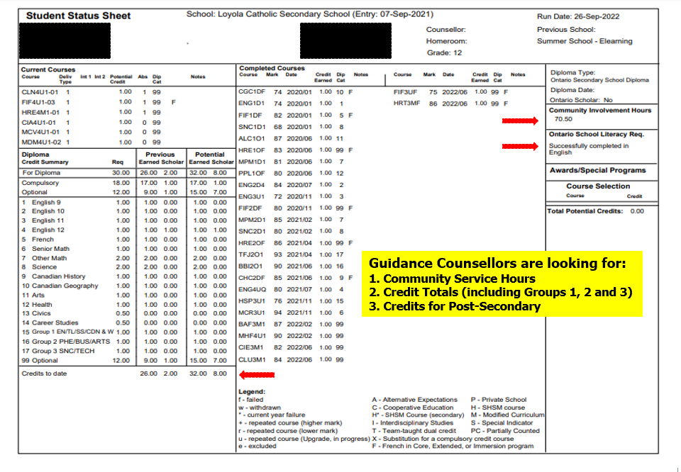
Guidance Counsellors are looking for:
Community Service Hours
Total Credits
Credits for Pathway

Slide 19


Take your time and review your course selection. Speak with your parents, Guidance Counsellor and SERT.
Check MyBlueprint for PowerPoints, Posters and Videos from the Departments at Loyola. Found in “Student Resources”.
Do not select a course you will be taking in summer school. Indicate this in the “Comment Section” of the Verification Sheet.
Parent/Guardian Verification Email is required.
Pay the $45 School Activity Fee through the School Cash Online site.
Select courses early to maintain your spot in courses with limited seats (i.e.: Technological Courses).
Do research on MyBlueprint, the Loyola Course Calender and post-secondary websites for information pertaining to future post-secondary programs.

Slide 20
If you have questions, make an appointment with your Guidance Counsellor on
Microsoft Teams (Code:aobp2pj).

